Slide 1



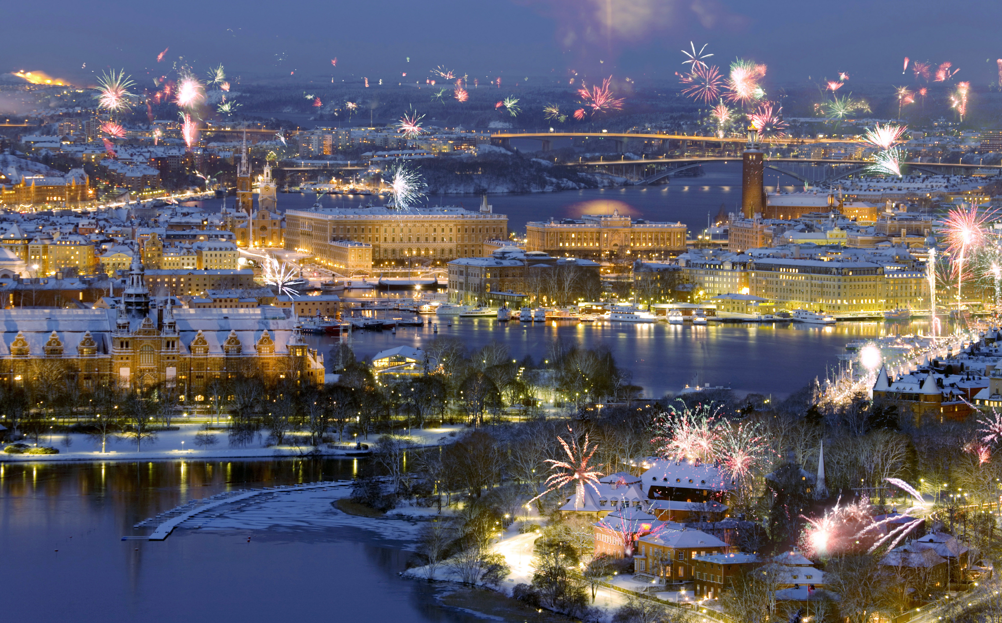
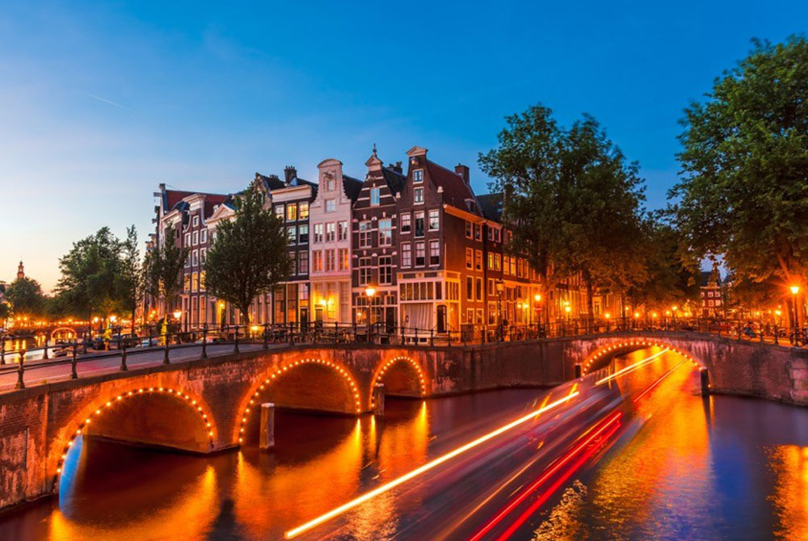
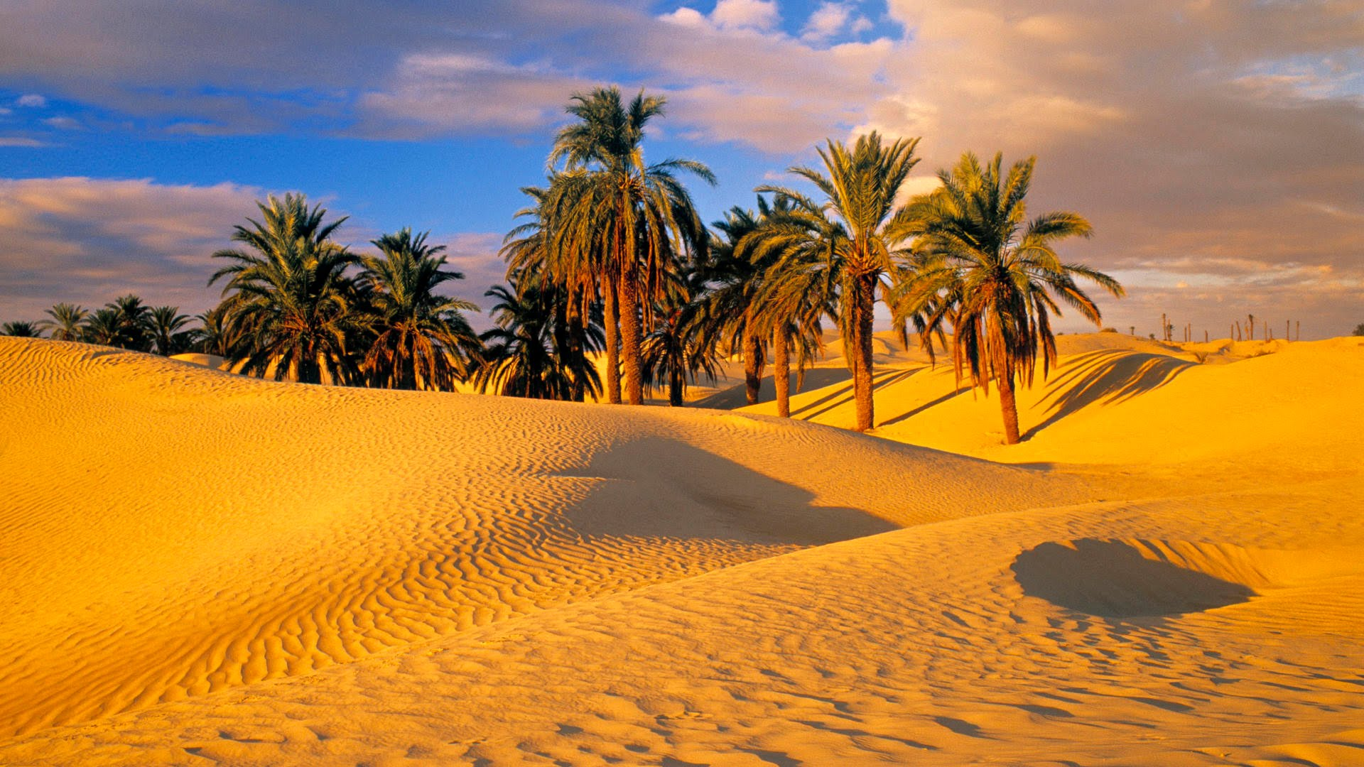
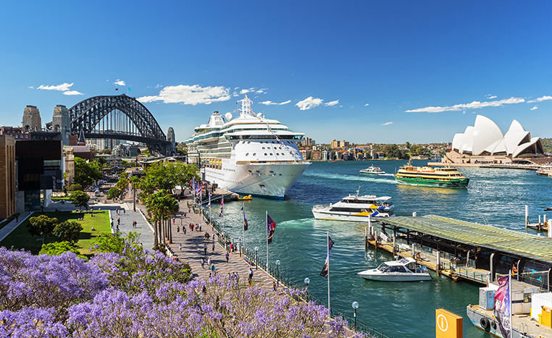
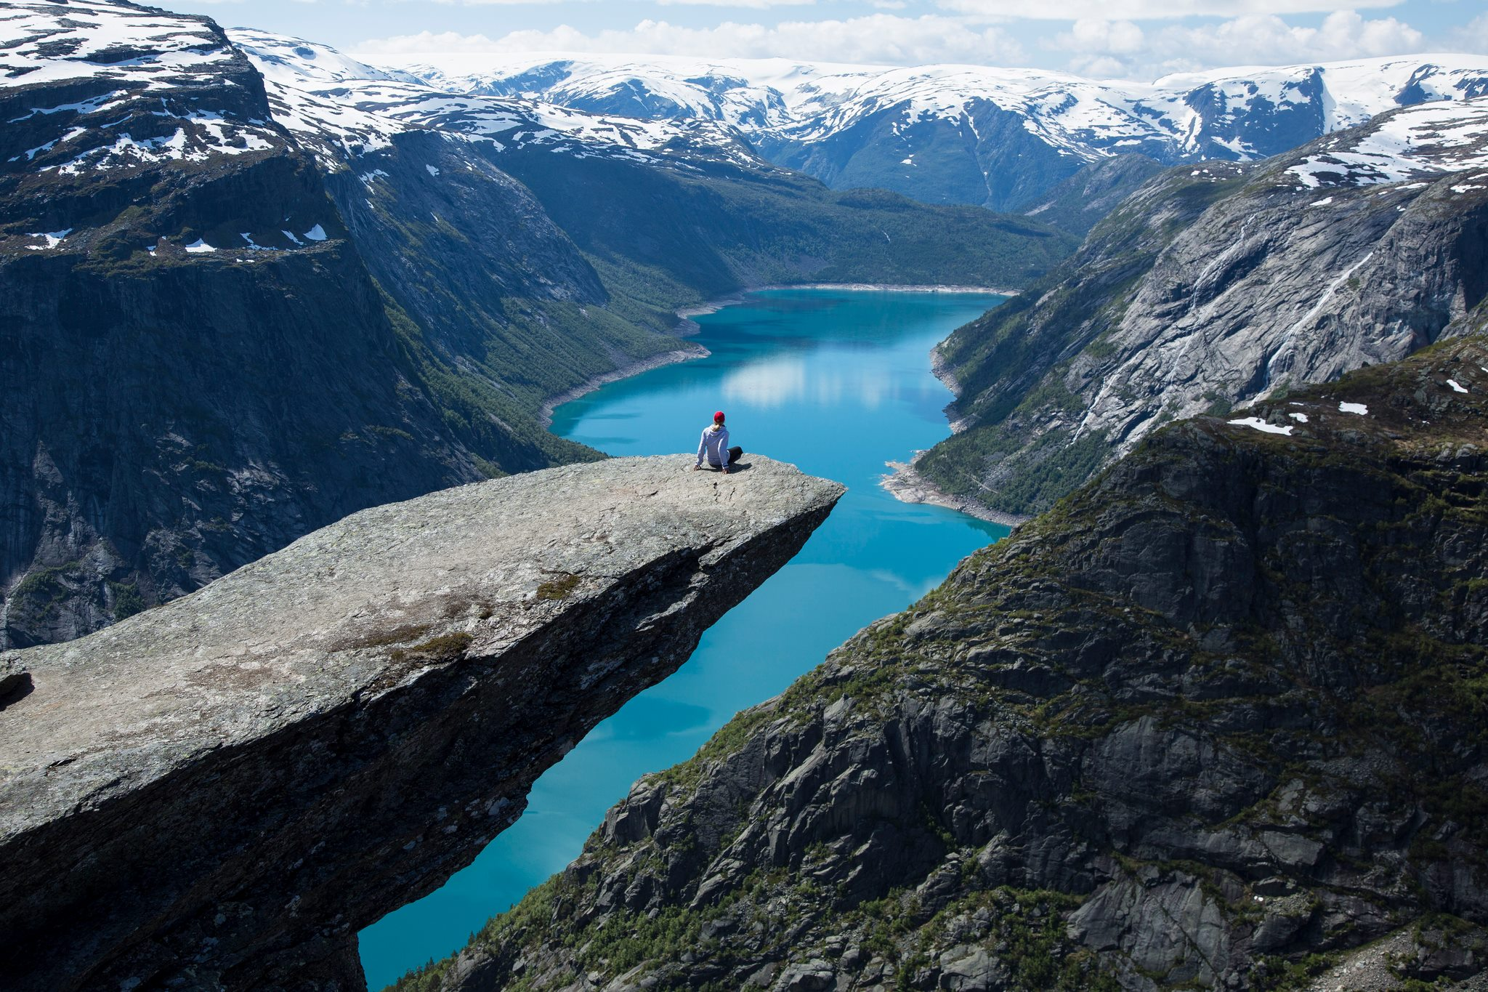
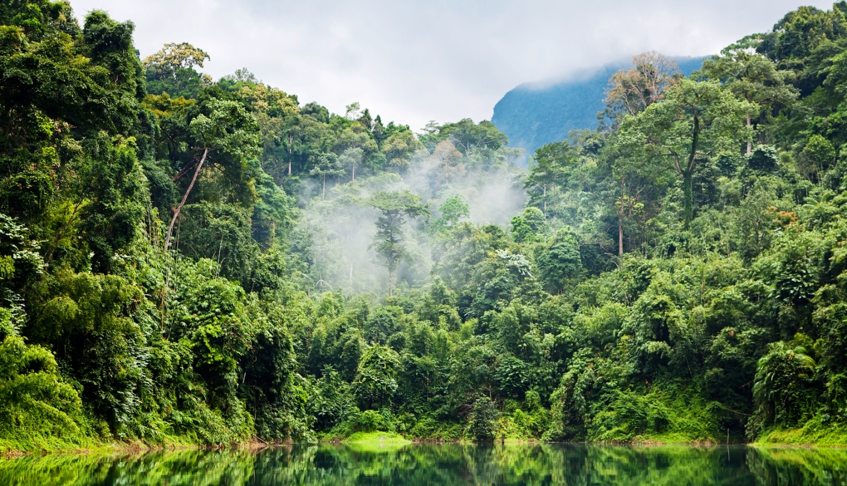
Travel World
Organize & discover the best trips in the world
Email or phone
Still without an account?
Password
Travel World – Jaén – 2018

Slide 2

Travel World
or
Email or phone
Username
Password
Validate Password
Travel World – Jaén – 2018

Slide 3
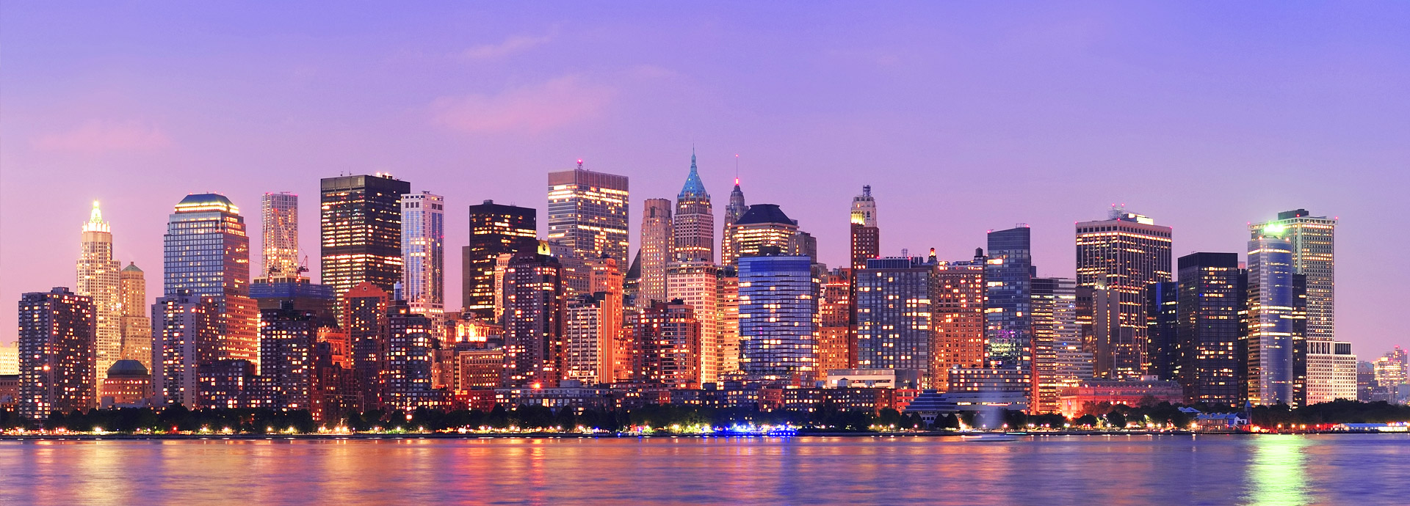
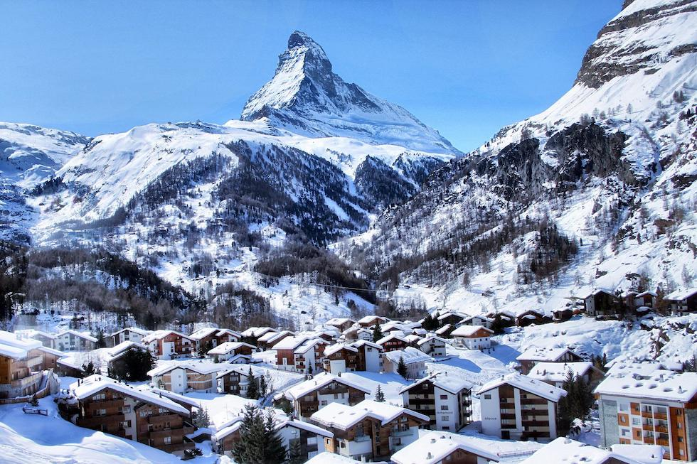
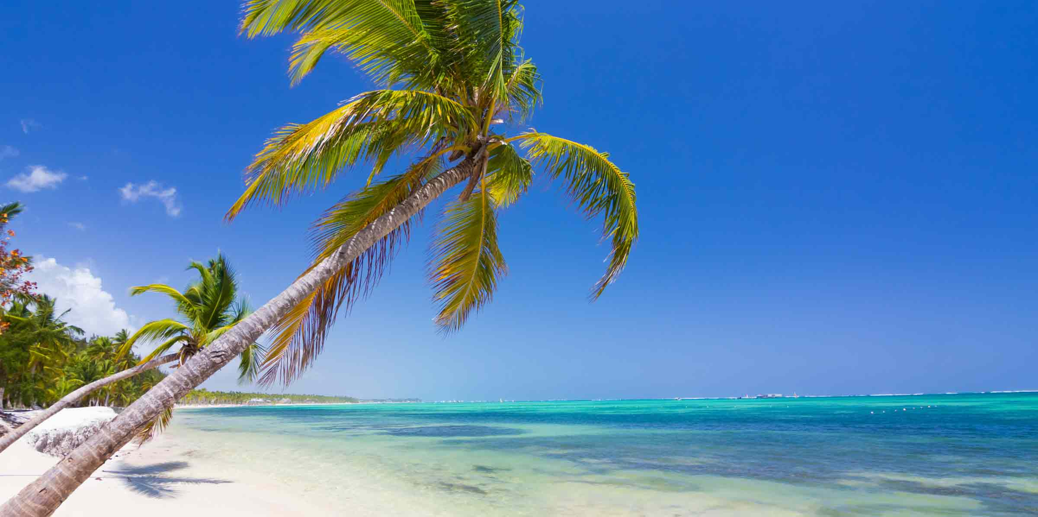
Travel World
Search
Intro
Activities
Items
Users
Messages
Your profile
Logout
Welcome to our web page!
-Have you ever wanted to travel but you have no inspiration?
-Have you ever doubt about how you will be or what you will see once abroad?
-Don't think it twice and check TravelWorld.com to get the inspiration you need!
Life, is an adventure
Travel World – Jaén – 2018

Slide 4

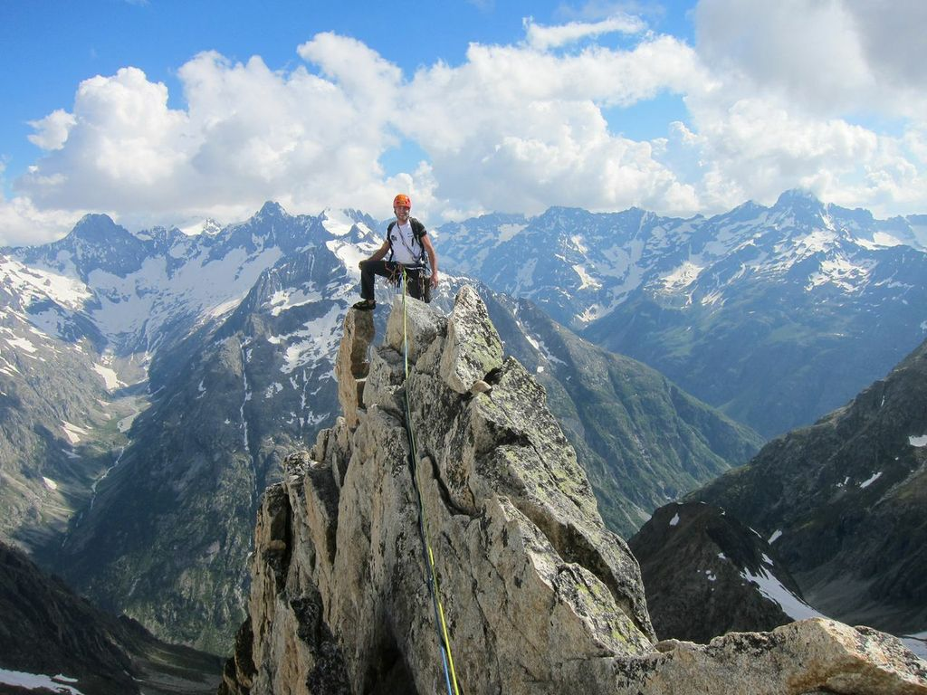
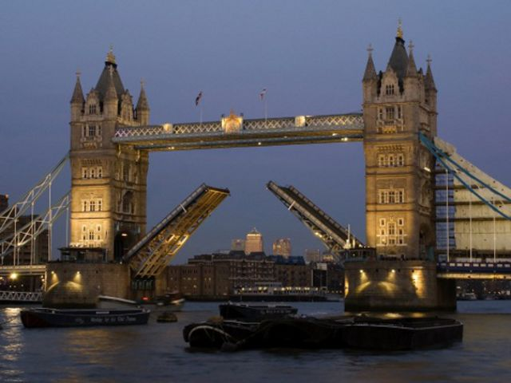
Travel World
Search
Intro
Activities
Items
Users
Messages
Your profile
Logout
French Alps
Climbing tour
Climbing morning (brief description)
London, UK
City sightseeing
Excursion day (brief description)
< 1 2 3 >
Travel World – Jaén – 2018

Slide 5
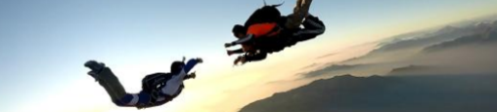
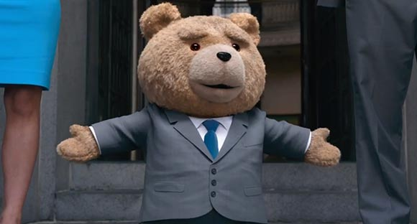

Travel World
Search
Intro
Activities
Items
Users
Messages
Your profile
Logout
Pepe pepote
Biography
Do you want to post something?
Trip Experience
French Alps
Climbing tour
Trip goals
Climbing morning (brief description)
Favorites
Travel World – Jaén – 2018

Slide 6

Travel World
Search
Intro
Activities
Items
Users
Messages
Your profile
Logout
Edit profile
Edit profile picture
Change password
Edit header picture
Name
Privacity
User name
Notifications
Biography
Mail
Phone number
Deactivate my account
Delete my account
Travel World – Jaén – 2018

Slide 7
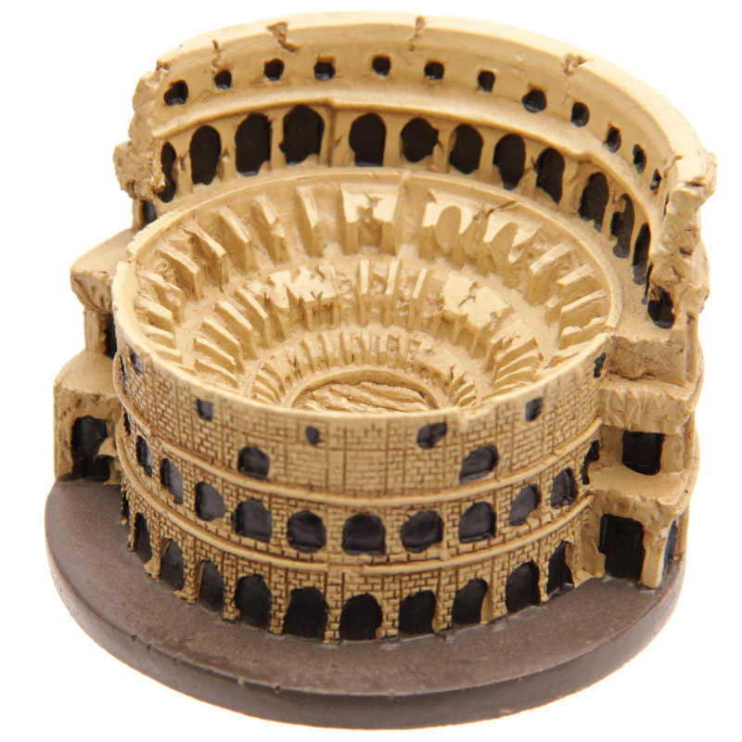
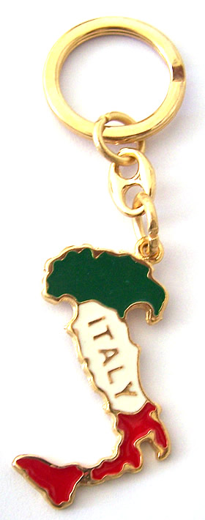
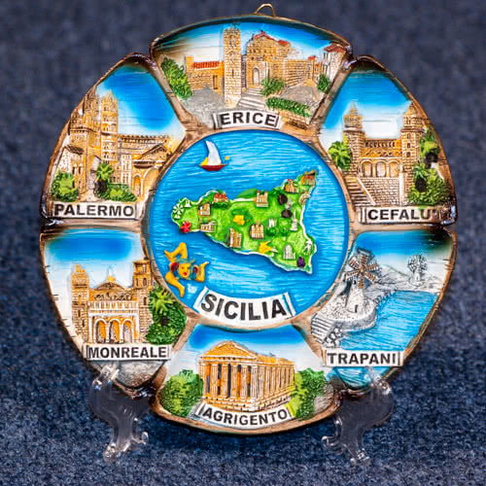

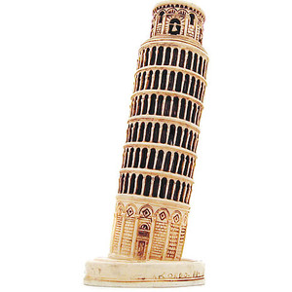
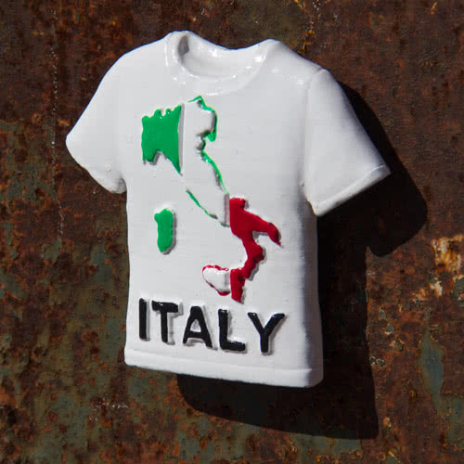
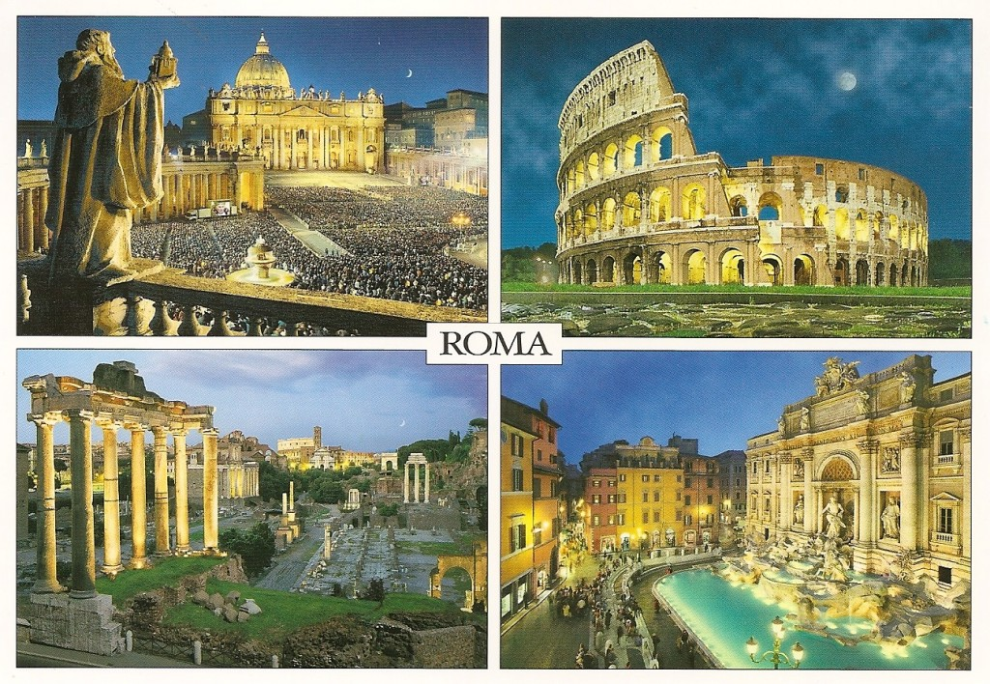

Travel World
Search
Intro
Activities
Items
Users
Messages
Your profile
Logout
Brief description
Brief description
Brief description
Rome Colisseum
Italy keyholder
Sicily plate
Brief description
Brief description
Brief description
Pisa tower
Italy magnet
Rome postcard
< 1 2 3 >
Travel World – Jaén – 2018

Slide 8

Travel World
Search
Intro
Activities
Items
Users
Messages
Your profile
Logout
Add friends
Your friend number 1
Your friend number 2
Your friend number 3
< 1 2 3 >
Travel World – Jaén – 2018

Slide 9


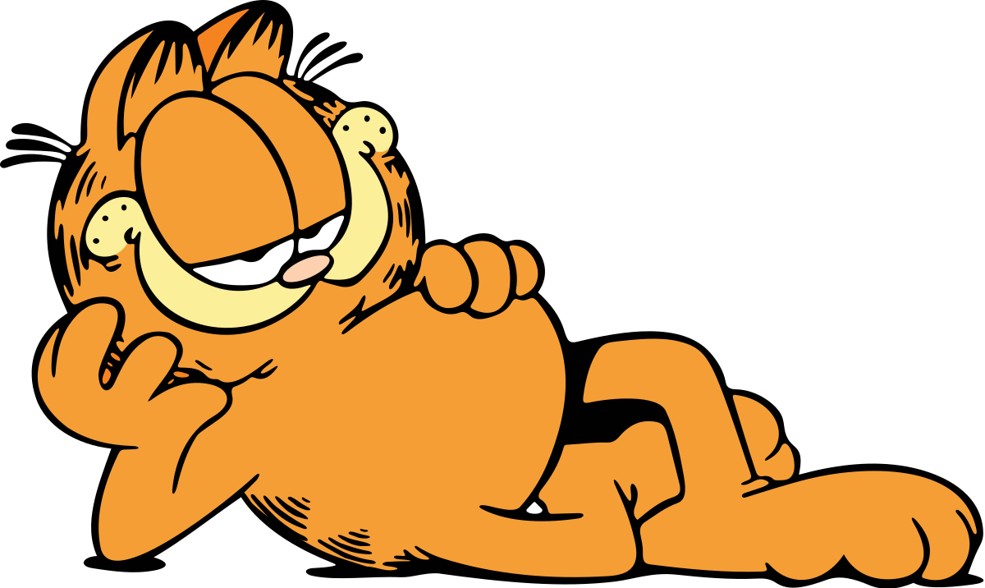
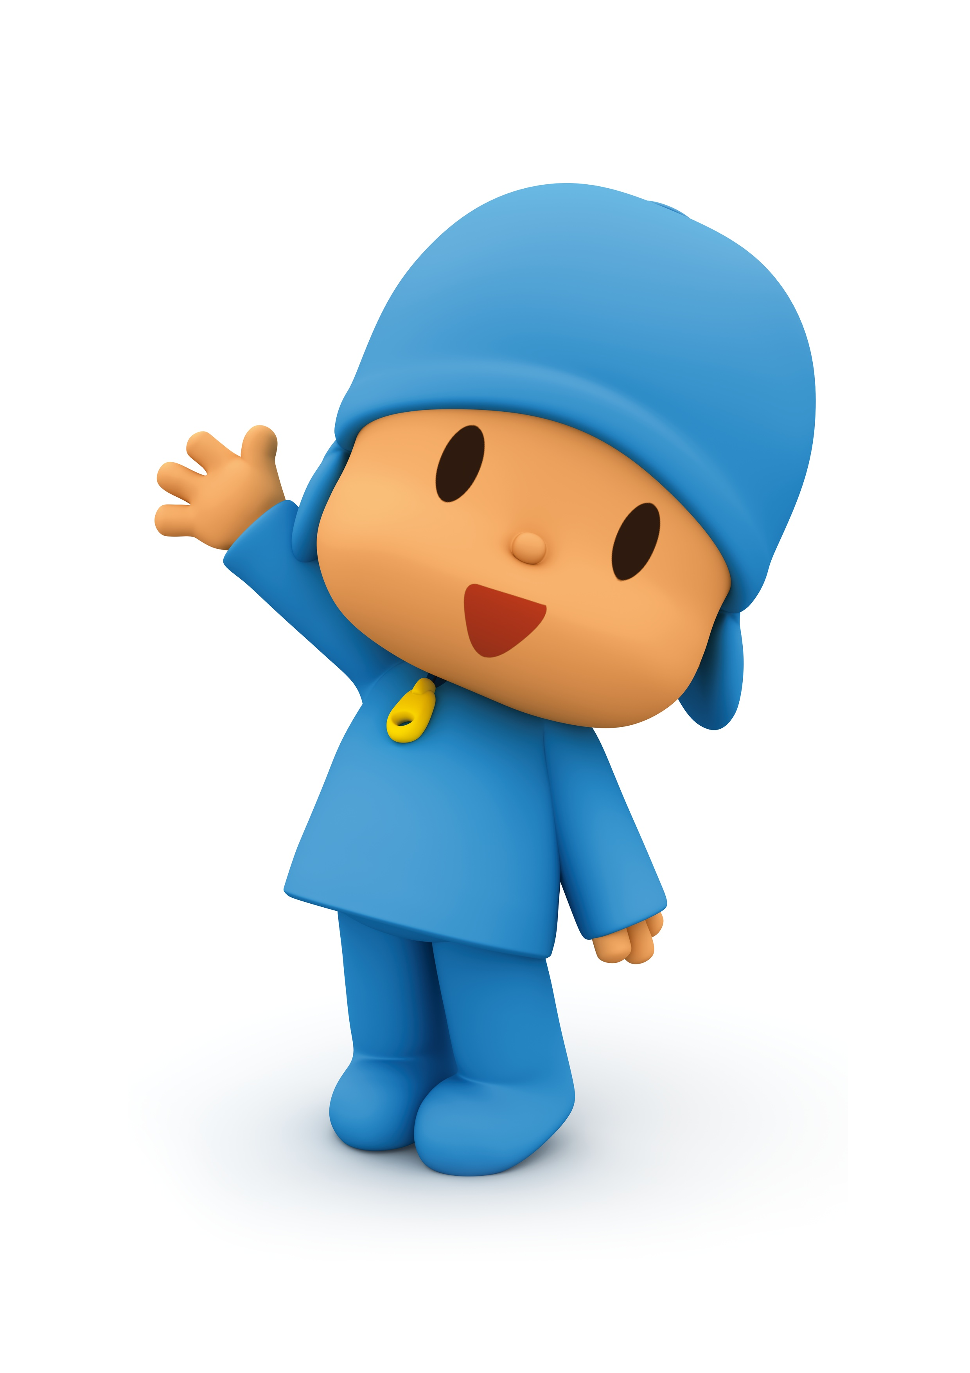
Travel World
Search
Intro
Activities
Items
Users
Messages
Your profile
Logout
Bob squarepants
Garfield
Pocoyo
< 1 2 3 >
Travel World – Jaén – 2018

Slide 10

Travel World
Search
Intro
Activities
Items
Users
Messages
Your profile
Logout
Add friends
Add title
Add content
Travel World – Jaén – 2018

Slide 11
Travel World
Umeå
Intro
Activities
Items
Users
Messages
Your profile
Logout
Users
Activities/Places
Items
Umeå's folk
institution
Umeå city-
sightseeing tour
Umeå's magnet
Umeå's university
Umeå fires
at Nydala
Umeå keyholder
Umeå's bilmuseet
Umevatoriet
night
Umeå internet
cable
Travel World – Jaén – 2018

